Slide 1
Guide for Parents & Families of FUTURE DOCTORS
Physicians medical forum
Doctors on board pipeline program
Saturday, APRIL 24, 2021

Slide 2
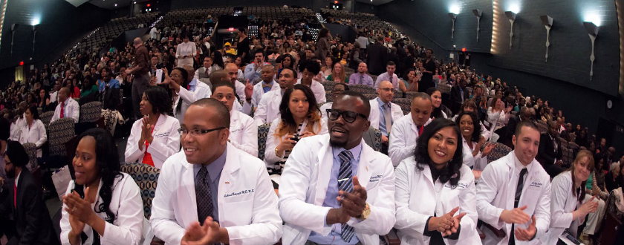
OVERVIEW
Introductions (15 mins)
Nuts & Bolts (20 mins)
Pre-med
Getting into medical school
Costs
Q & A session (55 mins)
Notes:
Ty [moderator] will welcome parents and go over the workshop’s overview
Start time ***
90 mins total time

Slide 3
PHYSICIANS MEDICAL FORUM
Notes:
Poll the audience and see how many parents/families have 1) high school kids 2) college kids 3) other?
Jump into panelist introductions here.
Spend 5 mins each telling who you are and give 1-2 points of advice on how your family/parents MOST supported you on your road to medical school and what you found most helpful

Slide 4
ASPIRING DOCTORS
Foundation in math and science
AP classes
Solid study habits, test-taking skills
Written and verbal communication skills
Extra-curricular activities – sustained over time
Volunteer in medical setting
Work in a lab
Shadow a doctor
Medical research
Leadership positions
Notes:
For kids in high school an important question is…
How can your high school students prepare now academically?
Sustaining over time during premedical years confirm your interest when applying to college and medical school
-allow you to meet potential mentors to help develop skills and motivate you

Slide 5
Extra-curricular activities
Notes:
To get into med school there needs to be a demonstration of a well-rounded sampling of extra-curricular activities or work experiences, both related and unrelated to medicine
SMDEP - summer medical and dental education program – at 18 locations across the country.
-Free six-week program for freshman and sophomore college kids who are underrepresented in medicine and dentistry. – free housing and meal costs
---academic enrichment
-- learning skills development
--clinical exposure and career development
Here on the pacific coast there are 3 programs 1) UCLA Charles Drew, Western University in Pomona, and University of Washington (Washington State)
From their website:
At the UCLA/Drew SHPEP, we are committed to developing future leaders that will change the face of medicine, dentistry and nursing as well as to improve health care delivery, policy and research in underserved communities. Our faculty advisors, caring staff, and campus community will enthusiastically support you as you pursue your personal goals and turn them into accomplishments.
The UCLA/Drew SHPEP mission is to serve as a model learning community in which scholars examine a variety of healthcare issues affecting medically underserved communities through problem-based learning cases, lectures, clinical experiences, small-group discussions, and a research project.

Slide 6
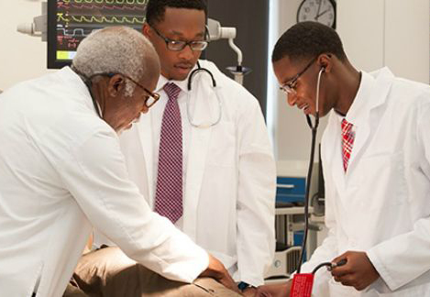
COLLEGE
Pre-Med ADVISOR
Mentor
Majors / GPA
MSAR $27
Pre-requisite Coursework
1 year of biology
1 year of physics
1 year of English
2 years of chemistry
BS-MD programs
Notes:
What should I think about when applying to colleges?
Most U.S. colleges will offer the required and recommended prerequisites asked for by medical schools. You also may wish to tour the lab facilities and science department classrooms. Consider whether your potential colleges have pre-health advisors, pre-health clubs, a relationship with a local hospital, or other helpful resources on campus or in the community that will help you sustain your motivation and meet your goals
mentor is a cheerleader; a mentor is a facilitator; a mentor is a motivator, and sometimes even a nudge.
Find a mentor that has your child’s best interest
BS-MD programs are 7 year programs that your child can enroll in after HS and in 7 year have both a Bachelors degree and a MD degree. Historically black Howard University, Meharry Medical college in Nashville,Tenessee, Penn State, Rush Medical College in Chicago, Texas A&M, UC San Diego, - are just to name a few.

Slide 7
Medical College Admissions Test (MCAT)
4 sections on the exam
Biological science
Chemical/physical science
Psychological/social science
Critical analysis & reasoning
Total score 472-528
When to take?
1 year before you enter medical school
Importance of exam
Alone it does not make or break your chances
www.aamc.org
Notes:
Take after they have completed basic level science courses, students will need to take the MCAT exam-- exam covers biology, physics, social sciene and critical analysis
l. Admissions committees consider many other factors when you apply, such as academic strengths, exposure to health care and medical research environments, personal experiences and interests, potential contributions to the campus and community, and personal attributes such as maturity and drive to help others

Slide 8
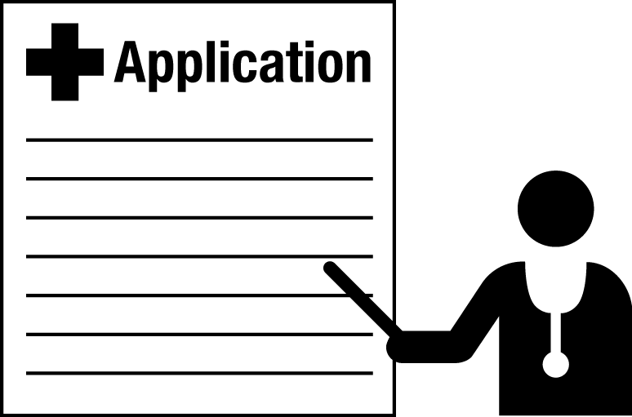
The Admissions Process
One primary application
Submit electronically via AMCAS
MCAT score, academic transcripts, personal statement, extra-curricular activities, letter of recommendations
Secondary applications
Personalized essays from each school
$50-150 per school
Interviews
Travel to each school and interview with faculty
50% offered an acceptance
Notes:
-There is rolling admission, so the earlier you apply, the earlier the programs will see your application and offer you a secondary. They each have a cap – so once 500 secondaries have been offered (for example), that’s it. It is very advantageous to apply on the first day that the application process is open
-Most applicants apply to about 30 programs for the primary. Roughly applications to programs 1-10 cost $200 then 11-20 cost $15 each. Then 20-30 cost $25 each.
-For competitive applicants they can expect to receive 12-20 secondary applications
-Then 10-12 interview offers. You don’t have to accept all interview offers.
-50% of students that get acceptance offers.

Slide 9
Costs of applying to medical school
Application Fees -- $2,000
MCAT
Primary & Secondary
Interviews – travel and accommodations
Fee Assistance Program
Based on parental income
Reduced MCAT registration fee
MCAT practice products
MSAR access
AMCAS with 15 medical schools [$664 value]
www.aamc.org
Notes:
The MCAT registration fee is $310 - $365.
Roughly you can expect to spend $2,000 on the application process to medical schools. The more schools you apply to, the more money it will cost you.
-AAMC (association of American medical college) does offer a Fee assistance program

Slide 10
Fall 2018
1st Yr College
Spring 2021
3rd Yr College
Take MCAT
Fall 2022
Start Medical School
Fall 2021
4th Yr College Start Applying
Fall 2019
2nd Yr College
Fall 2020
3rd Yr College
Notes:
Here is a general illustration of the process

Slide 11
Fall 2018
1st Yr College
Spring 2021
3rd Yr College
Take MCAT
Fall 2022
Start Medical School
Fall 2021
4th Yr College Start Applying
Fall 2019
2nd Yr College
Fall 2020
3rd Yr College
Some students go like this
…But still end up here!
Notes:
This is the most distilled and straight way. But not every student will have this linear progression. There may be a break for work, for research, for maturity, for second-guessing, for family. For whatever. …But keeping the goal in mind is the most important thing.
For me, I took 2 years off between 4th year of college and starting medical school. During that time I enrolled in a post baccalaureate program to enhance my academic record.

Slide 12
