Slide 1
Finding the Perfect Fit Primary care & Specialty care
Italo M. Brown, MD MPH
Emergency Medicine Physician – Bronx NY
Tour for Diversity in Medicine Mentor

Slide 2
So you Wanna practice medicine…
…Not so fast.

Slide 3
Think to yourself…
What do YOU want to do?
What are your options?
To cut or not to cut?
Old vs. young vs. everyone?
People vs. no people?
Inpatient vs. outpatient?

Slide 5
Primary Care
First Contact & Continuity of Care
Core disciplines
Internal Medicine
Family Medicine
Pediatrics
Gynecology
Typically 3 – 4 years of training
Eligible for loan forgiveness programs
Base pay $160K - $250K

Slide 6
Internal Medicine
Sees ONLY ADULTS
Prevention, diagnosis and treatment of diseases
Clinic + Wards, no OR
Flexible hours
Opportunities
Subspecialty Care

Slide 7
Family Medicine
Sees Everybody
General health management of all ages
Clinic, +/- Wards, no OR
Flexible hours
Opportunities!

Slide 8
Pediatrics
Sees newborns to age 21
General health management
Clinic, +/- Wards, no OR
Flexible hours
Opportunities
Subspecialty Care

Slide 9
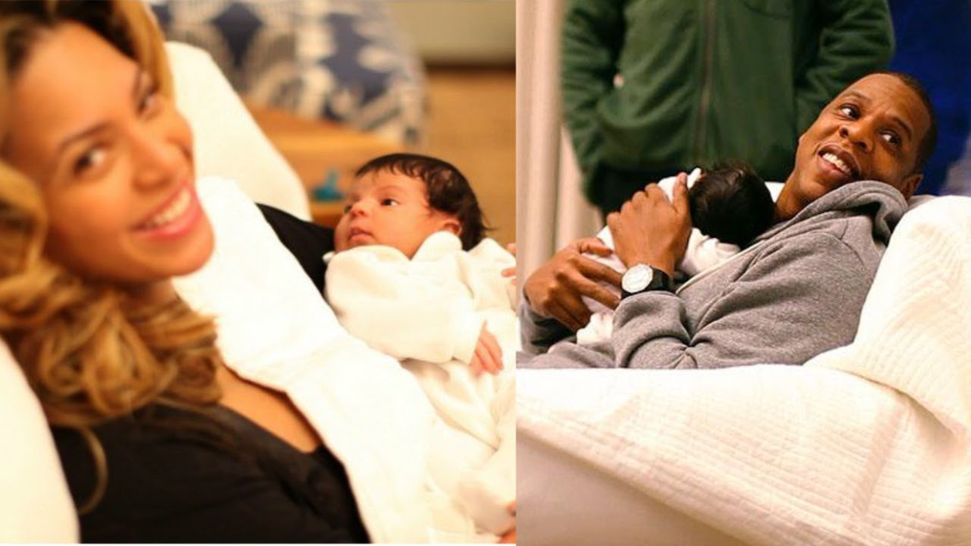
Obstetrics and Gynecology (OB-GYN)
Hybrid | PCP + Surgeon
Complete care of the female patient
Clinical Work, + Wards, +/- OR
Lots of opportunities
Subspecialty Care

Slide 10
Specialty Field
Focused on a defined organ system or population
Typically involves invasive care
Requires MORE training (4 – 7 years)
May require research
Base pay $300K - $600K
Not eligible for loan forgiveness

Slide 11
Anesthesiology
Manages entire care before, during and after surgery
Mostly sees adults
Manages difficult airway issues
Does not do clinical work or wards
Well-compensated

Slide 12
Dermatology
Manages disorders of the skin, hair and nails
Sees adults and kids
Clinic, no wards or OR
Highly competitive due to lifestyle
Very well-compensated

Slide 13
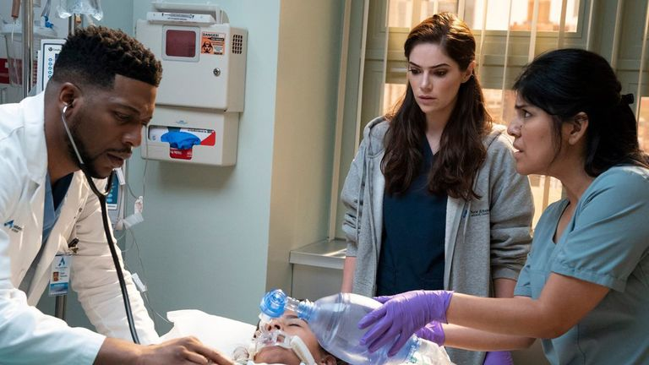
Emergency Medicine
Addresses any injuries/illnesses requiring immediate attention.
Sees everyone. I mean EVERYONE.
Hybrid | Primary care + Surgery
No clinic, no wards, no OR.
Flexible; Well-compensated
Opportunities galore!

Slide 14
Neurology & Neurosurgery
Manages disorders of the nervous system
Neurosurgery = Intervention & Repair
Sees adults and kids
Neurology = No OR; Neurosurgery = OR primarily
Bread & butter
Neuro: Headaches, Strokes & Seizures
Neurosurgery: Brain-bleeds & Tumors
Cool stuff all the time

Slide 15
Ophthalmology
Diagnosis and treatment of eye disorders.
Clinic and OR, +/- wards
Highly competitive
Very well-compensated

Slide 16
Orthopedic Surgery
Bones, Joints, Tendons, Ligaments
Sees adults and kids
Works with hands
OR + Clinic, +/- Wards
Very Well-Compensated
Cool Stuff all the time

Slide 17
Otolaryngology (ENT)
All things related to the Ear, Nose, and Throat
Sees adults and kids
Use cool devices
Clinic + OR, +/- Emergency settings
Very Well-compensated

Slide 18
Pathology
Examines samples of body tissue for diagnostic or forensic purposes
Sees adults and kids
In the lab primarily
Well-compensated
Opportunities

Slide 19
Physical Medicine & Rehabilitation
Improving mobility and restoring physical quality of life
Mostly adults
Clinic primarily
Flexible hours
Well-compensated
Opportunities

Slide 20
Plastic Surgery
Restores, reconstructs and alters the human body
Sees Everybody
Clinic, +/- Wards, no OR
Highly competitive due to lifestyle
Very well-compensated
Opportunities galore!

Slide 21
Psychiatry
Addresses mental and psychological conditions
Sees adults and kids
Not Psychologists or Therapists
CLINIC, +/- Wards
Flexible
Well-compensated

Slide 22
Radiology
Uses medical imaging to diagnose and treat diseases
Sees Everybody…but not in-person.
Radiology suite…but can work remotely.
Flexible hours
Well-compensated
Opportunities!

Slide 23
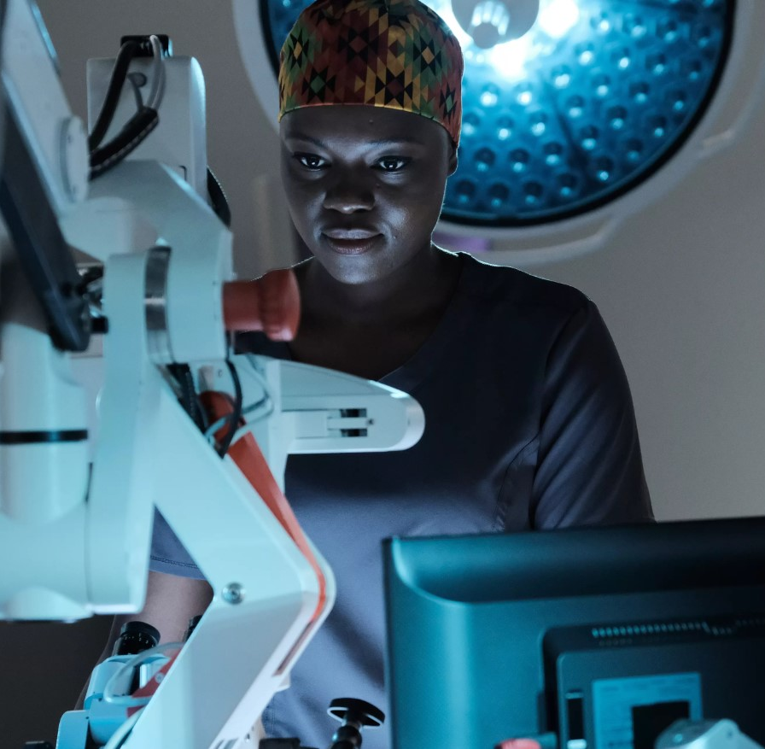
General Surgery
Treats medical conditions involving many organ systems
Provides operative management
Sees adults and kids
OR + Clinic + Wards
Well-compensated
Opportunities
Sub-specialties

Slide 24
Urology (GU)
All things related to the genitourinary system
Sees adults primarily, but can see kids
OR + Clinic, rarely wards
Bread & Butter = Kidney stones & Male issues (i.e. Vasectomies)
Very Well-compensated

Slide 25
Outside the Box
Public
Health
Administration
Health Policy
Academic Medicine
Media/Journalism
Consulting
Concierge

Slide 26
So now that you know the landscape…

